Slide 1

Your Favorite JavaScript Frameworks ASP.NET Core
meet
SHAYNE BOYER
SR. CLOUD DEVELOPER ADVOCATE, MICROSOFT
@spboyer

Slide 2
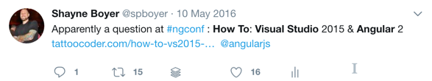

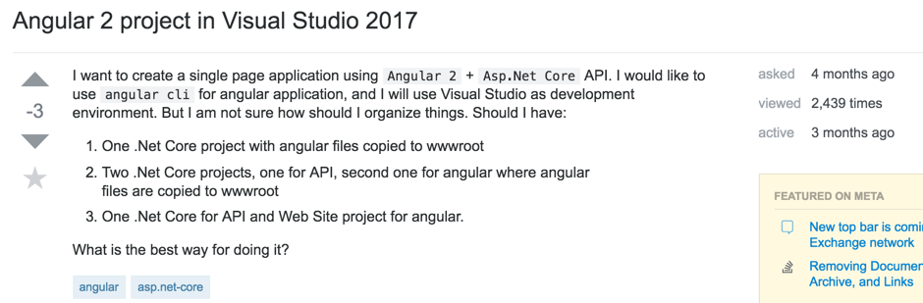
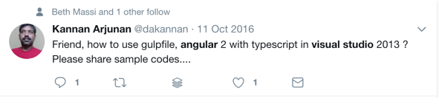
How do I Angular?

Slide 3
How do I Angular?

Slide 4
How do I Angular?

Slide 5
How do I Angular?

Slide 6
How do I Angular?

Slide 7
Babel
ASP.NET Core
developers
?
Karma
Mocha
MobX
Redux
Flux
Jasmine
Angular
React
Aurelia
Knockout
Vue.js
Grunt
ES5
ES2016
ES2017
TypeScript
Gulp
Webpack
SASS
LESS
PostCSS
Rollup

Slide 8







> dotnet new
Notes:
Cogs image from http://absurdwordpreferred.deviantart.com/art/Cogs-transparent-PNG-147488435 - free to use, no attribution required

Slide 9


> dotnet new
Notes:
Cogs image from http://absurdwordpreferred.deviantart.com/art/Cogs-transparent-PNG-147488435 - free to use, no attribution required

Slide 10
In this talk
Building your SPA
Inside Webpack
Getting started
Webpack / HMR
Prerendering
Debugging
Tests

Slide 11
In this talk

Slide 12
Make Connections Count
Getting Started
1
Webpack / Hot Module Replacement (HMR)
2
Prerendering
3
In this talk
Debugging
4
Tests
5
Inside Webpack
6
Notes:
Samples are also included in download for this course, for Plus subscribers.

Slide 13
In this talk
1
Getting Started
Webpack / Hot Module Replacement (HMR)
2
Prerendering
3
Debugging
4
Tests
5
Inside Webpack
6
Notes:
Samples are also included in download for this course, for Plus subscribers.

Slide 14
In this talk
1
Getting Started
2
Webpack / Hot Module Replacement (HMR)
Prerendering
3
Debugging
4
Tests
5
Inside Webpack
6
Notes:
Samples are also included in download for this course, for Plus subscribers.

Slide 15
In this talk
1
Getting Started
2
Webpack / Hot Module Replacement (HMR)
3
Prerendering
Debugging
4
Tests
5
Inside Webpack
6
Notes:
Samples are also included in download for this course, for Plus subscribers.

Slide 16
In this talk
1
Getting Started
2
Webpack / Hot Module Replacement (HMR)
3
Prerendering
4
Debugging
Tests
5
Inside Webpack
6
Notes:
Samples are also included in download for this course, for Plus subscribers.

Slide 17
In this talk
1
Getting Started
2
Webpack / Hot Module Replacement (HMR)
3
Prerendering
4
Debugging
5
Tests
Inside Webpack
6
Notes:
Samples are also included in download for this course, for Plus subscribers.

Slide 18
In this talk
1
Getting Started
2
Webpack / Hot Module Replacement (HMR)
3
Prerendering
4
Debugging
5
Tests
6
Inside Webpack
Notes:
Samples are also included in download for this course, for Plus subscribers.

Slide 19
In this talk
1
Getting Started
2
Webpack / Hot Module Replacement (HMR)
3
Prerendering
4
Debugging
5
Tests
6
Inside Webpack
Notes:
Samples are also included in download for this course, for Plus subscribers.

Slide 20
In this talk
1
Getting Started
2
Webpack / Hot Module Replacement (HMR)
3
Prerendering
4
Debugging
5
Tests
6
Inside Webpack
Notes:
Samples are also included in download for this course, for Plus subscribers.

Slide 21
In this talk
1
Getting Started
2
Webpack / Hot Module Replacement (HMR)
3
Prerendering
4
Debugging
5
Tests
6
Inside Webpack
Notes:
Samples are also included in download for this course, for Plus subscribers.

Slide 22
In this talk
1
Getting Started
2
Webpack / Hot Module Replacement (HMR)
3
Prerendering
4
Debugging
5
Tests
6
Inside Webpack
Notes:
Samples are also included in download for this course, for Plus subscribers.

Slide 23
In this talk
1
Getting Started
2
Webpack / Hot Module Replacement (HMR)
3
Prerendering
4
Debugging
5
Tests
6
Inside Webpack
Notes:
Samples are also included in download for this course, for Plus subscribers.

Slide 24
In this talk
Building your SPA
Inside Webpack
Getting started
Webpack / HMR
Prerendering
HTTP priming
Tests
✔
✔
✔
✔

Slide 25
What is Angular Universal?
Better Perceived Performance
1
Optimized for Search Engines
2
Site Preview
3
Notes:
Better Perceived Performance
First time users of your application will instantly see a server rendered view which greatly improves perceived performance and the overall user experience. According to research at Google, the difference of just 200 milliseconds in page load performance has an impact on user behavior.
Optimized for Search Engines
Although Googlebot crawls and renders most dynamic sites, many search engines expect plain HTML. Server-side pre-rendering is a reliable, flexible and efficient way to ensure that all search engines can access your content.
Site Preview
Ensure that Facebook, Twitter and all other social media apps correctly display a preview image of your app.

Slide 26
What is Angular Universal?
1
Better Perceived Performance
Optimized for Search Engines
2
Site Preview
3
Notes:
Better Perceived Performance
First time users of your application will instantly see a server rendered view which greatly improves perceived performance and the overall user experience. According to research at Google, the difference of just 200 milliseconds in page load performance has an impact on user behavior.
Optimized for Search Engines
Although Googlebot crawls and renders most dynamic sites, many search engines expect plain HTML. Server-side pre-rendering is a reliable, flexible and efficient way to ensure that all search engines can access your content.
Site Preview
Ensure that Facebook, Twitter and all other social media apps correctly display a preview image of your app.

Slide 27
What is Angular Universal?
1
Better Perceived Performance
2
Optimized for Search Engines
Site Preview
3
Notes:
Better Perceived Performance
First time users of your application will instantly see a server rendered view which greatly improves perceived performance and the overall user experience. According to research at Google, the difference of just 200 milliseconds in page load performance has an impact on user behavior.
Optimized for Search Engines
Although Googlebot crawls and renders most dynamic sites, many search engines expect plain HTML. Server-side pre-rendering is a reliable, flexible and efficient way to ensure that all search engines can access your content.
Site Preview
Ensure that Facebook, Twitter and all other social media apps correctly display a preview image of your app.

Slide 28
What is Angular Universal?
1
Better Perceived Performance
2
Optimized for Search Engines
3
Site Preview
Notes:
Better Perceived Performance
First time users of your application will instantly see a server rendered view which greatly improves perceived performance and the overall user experience. According to research at Google, the difference of just 200 milliseconds in page load performance has an impact on user behavior.
Optimized for Search Engines
Although Googlebot crawls and renders most dynamic sites, many search engines expect plain HTML. Server-side pre-rendering is a reliable, flexible and efficient way to ensure that all search engines can access your content.
Site Preview
Ensure that Facebook, Twitter and all other social media apps correctly display a preview image of your app.

Slide 29
Angular ahead-of-time (AoT) compilation
dev
1050 KB
Total page size
(compression enabled)
prod
514 KB
prod + AoT
402 KB
dev
547 ms
Startup CPU time
(after prerender,
median over 5 runs)
prod
422 ms
prod + AoT
223 ms
Scenario: ASP.NET Core 2.0 Angular template in Chrome on up-to-date laptop

Slide 30
Angular ahead-of-time (AoT) compilation
dev
1050 KB
Total page size
(compression enabled)
prod
514 KB
prod + AoT
402 KB
dev
547 ms
Startup CPU time
(after prerender,
median over 5 runs)
prod
422 ms
prod + AoT
223 ms
Scenario: ASP.NET Core 2.0 Angular template in Chrome on up-to-date laptop

Slide 31
In this talk
Building your SPA
Inside Webpack
Getting started
Webpack / HMR
Prerendering
Debugging
Tests
How it works
Extending your build system
✔
✔
✔
✔
✔

Slide 32
ENTRY POINT
NPM
NPM
.ts
.ts
.ts
.js
.js
.js
ts-loader
js-loader
.ts
HTML
CSS
CSS
PNG
html-loader
css-loader
file-loader
url-loader
?
(etc.)
.ts
???-loader

Slide 33
ENTRY POINT
NPM
NPM
PLUGINS
.ts
.ts
.ts
.js
.js
.js
minification
lazy loading
ts-loader
js-loader
etc.
.ts
HTML
CSS
CSS
PNG
…
…
…
html-loader
css-loader
file-loader
url-loader
main.js
a.css
b.png
?
(etc.)
.ts
???-loader

Slide 34
In this talk
Building your SPA
Inside Webpack
Getting started
Webpack / HMR
Prerendering
HTTP priming
AoT & Publish
Debugging
Tests
How it works
Extending your build system
✔
✔
✔
✔
✔
✔
✔
✔
✔

Slide 35
Adding SASS styling
Example: styles.sass
$myColor: red; { color: myColor; }
Add Appropriate Loader to Webpack: npm install sass-loader
module: {
rules: [
{ test: /\.ts$/, include: /ClientApp/, use: isDevBuild ? ['awesome-typescript-loader?silent=true', 'angular2-template-loader'] : '@ngtools/webpack' },
{ test: /\.html$/, use: 'html-loader?minimize=false' },
{ test: /\.css$/, use: [ 'to-string-loader', isDevBuild ? 'css-loader' : 'css-loader?minimize' ] },
{ test: /\.sass/, use: [ 'to-string-loader', ‘sass-loader’, 'css-loader' ] },
{ test: /\.(png|jpg|jpeg|gif|svg)$/, use: 'url-loader?limit=25000' }
]

Slide 36
In this talk
1
Getting Started
2
Webpack / Hot Module Replacement (HMR)
3
Prerendering
4
Debugging
5
Tests
6
Inside Webpack
Notes:
Samples are also included in download for this course, for Plus subscribers.

Slide 37
your app
Microsoft.AspNetCore.
SpaServices
Prerendering
Webpack middleware
Routing
Microsoft.AspNetCore.
NodeServices
Server-side JavaScript
Node.js

Slide 38
In this talk
Building your SPA
Inside Webpack
Getting started
Webpack / HMR
Prerendering
HTTP priming
AoT & Publish
Debugging
Tests
How it works
Extending your build system
✔
✔
✔
✔
✔
✔
✔
✔
✔

Slide 39
> dotnet new
Notes:
Cogs image from http://absurdwordpreferred.deviantart.com/art/Cogs-transparent-PNG-147488435 - free to use, no attribution required

Slide 40
learn more
https://github.com/aspnet/JavaScriptServices
https://aka.ms/spaservicesdocs
Shayne Boyer, Microsoft
@spboyer
Thanks!
Notes:
Cogs image from http://absurdwordpreferred.deviantart.com/art/Cogs-transparent-PNG-147488435 - free to use, no attribution required

